Slide 1
MVC pattern
Juan Luis Gorricho

Slide 2
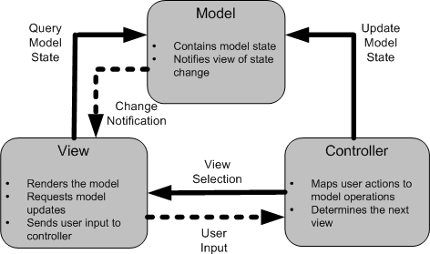
Web applications design pattern

Slide 3


Service schema
1
Controller Servlet
2
HTML
request page
Action
7
8
3
6
HTML reply page
9
View: JSP
reply page
Model objects
4
5
Client
Server
Entity Manager
Data Base

Slide 4

Actions
All actions implement the interface Action:
public interface Action {
public abstract void perform(HttpServletRequest req, HttpServletResponse resp) throws Exception;
}
Any implementation of “perform” method has for last sentence:
ViewManager.nextView(req, resp, "/view/next_view.jsp");

Slide 5

ViewManager
The ViewManager is a static class forwarding the request to the next view:
public static void nextView(… req, … resp, String jsp) { try {
RequestDispatcher dispatcher = req.getRequestDispatcher(jsp); if (dispatcher != null) {
dispatcher.forward(req, resp);
}
} catch (Exception e) {
System.out.println("Error at dispatcher in nextView " + e.toString());
}
}

Slide 6

ControllerServlet
On web.xml all actions (*.do) are mapped to the ControllerServlet
The init() method on the ControllerServlet creates a HashMap adding all available actions
The doPost or doGet identifies and performs the corresponding action

Slide 7

ContextListener
The ContextListener retrieves the EntityManager and UserTransaction references and creates those objects with application scope: CategoryModel and ProductModel in charge of accessing the DDBB
The objects with application scope are accessible thru the ServletContext

Slide 8






Actions
Actions to be coded:
  initAction: shows all categories
  categoryAction: shows all items of one category
  neworderAction: adds a new item to the shopping cart
  viewcartAction: shows the shopping cart
  updatecartAction: updates the shopping cart items
  clearcartAction: removes all items from the shopping cart
  checkoutAction: performs the buy action

Slide 9



Web pages
The web pages directory contains all JSPs with the views and any complementary files, in particular:
  img subdirectory with all images,
  view subdirectory with all view JPSs
  3 complementary JSP files on the root directory: start.jsp, error.jsp and undone.jsp.

Slide 10


ShoppingCart
Methods:
public synchronized void addItem(Product product)
public synchronized void update(Product product, int quantity) public synchronized List<ShoppingCartItem> getItems() public synchronized int getNumberOfItems()
public synchronized double getTotal() public synchronized void clear()

Slide 11












ShoppingCartItem
Methods:
public ShoppingCartItem(Product product) public Product getProduct()
public int getQuantity()
public void setQuantity(int quantity) public double getTotal()

Slide 12
Exercise
Download the ecommerce_exercise
Restore the ecommerce.sql database script
Open the ecommerce_exercise from NetBeans and set up the database connection as requested
Deploy the web application and check the access to the initial page of the virtual grocery market

Slide 13
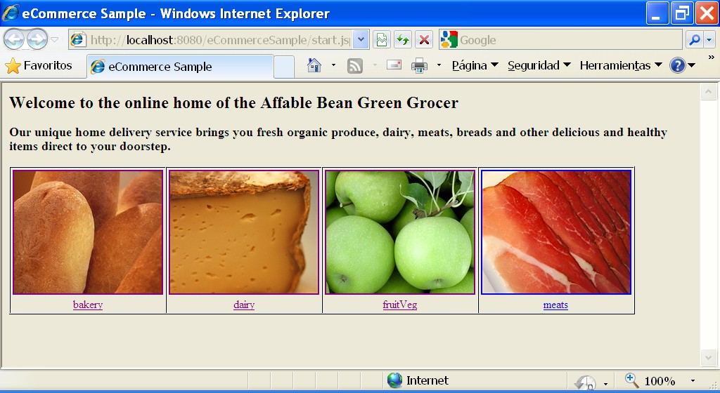
eCommerce portal prototype

Slide 14
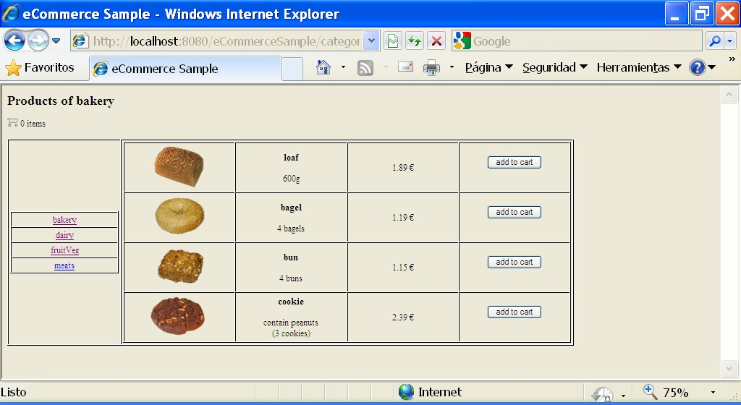
eCommerce portal prototype

Slide 15
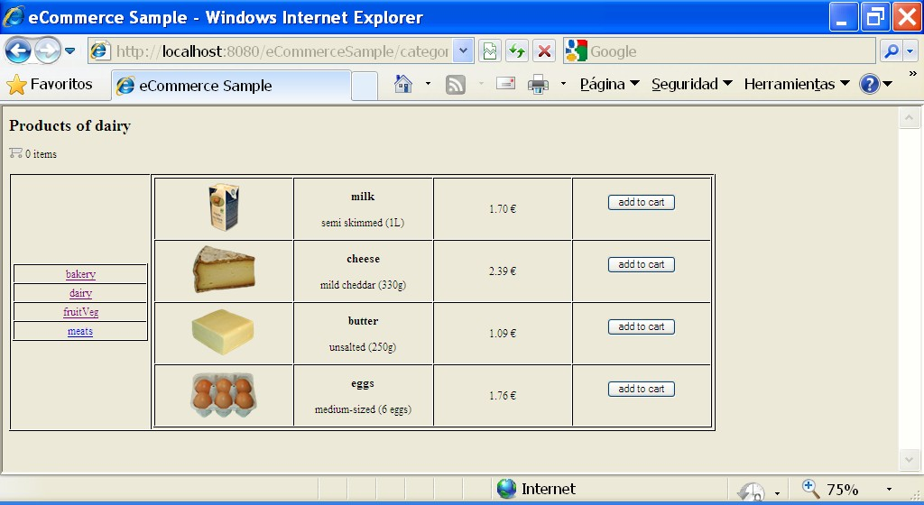
eCommerce portal prototype

Slide 16
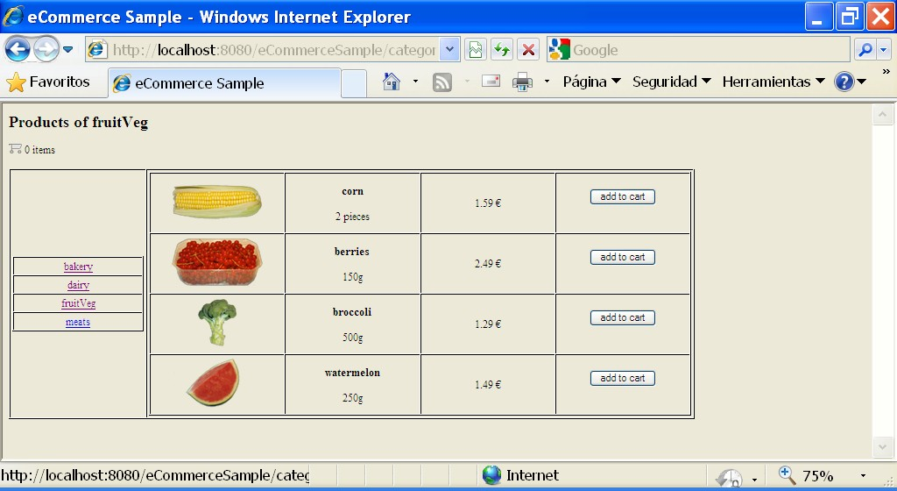
eCommerce portal prototype

Slide 17
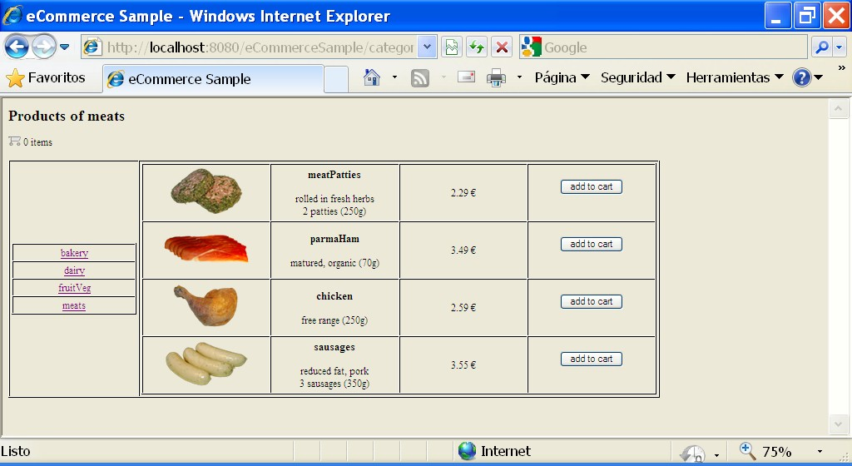
eCommerce portal prototype

Slide 18
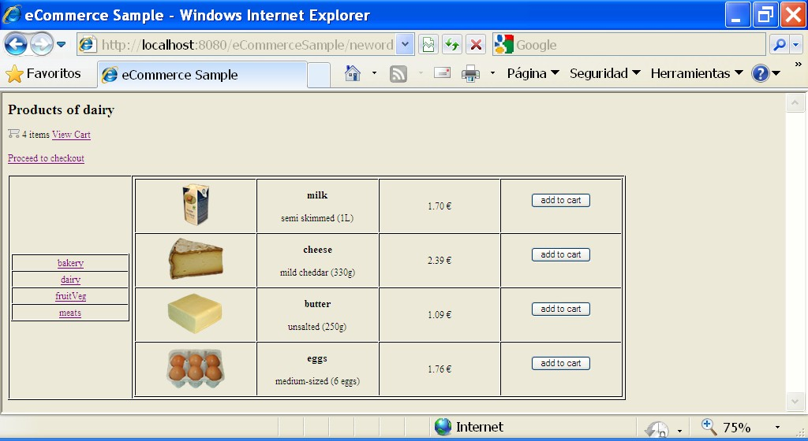
eCommerce portal prototype

Slide 19
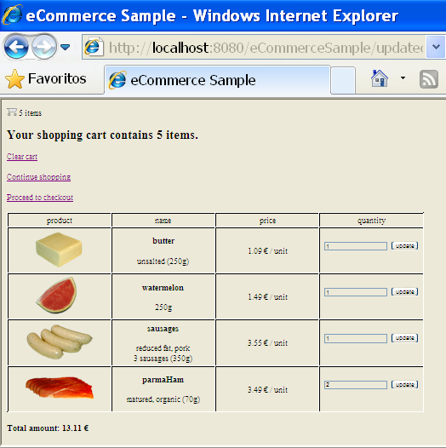
eCommerce portal prototype

